Slide 1

Captain Park
Road Side Park Detect System
Chen xi; Pang Zhengqi; Su Zhaofan; Xu Mengru; Yang Liuqing
Notes:
Good afternoon, distinguished professors and students, our topic is Road Side Park Detect System. We call it captain park.

Slide 2

What is the problem?
01
Quickly locate the specific locations of the free parking spaces near the destination
Notes:
To begin with, What is the problem our group want to solve? -“Quickly locate the specific locations of the free parking spaces near the destination.” Let’s show it. 表演

Slide 3

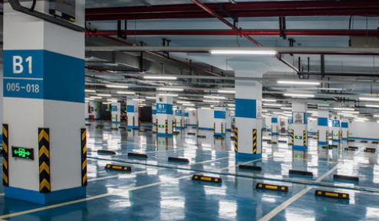
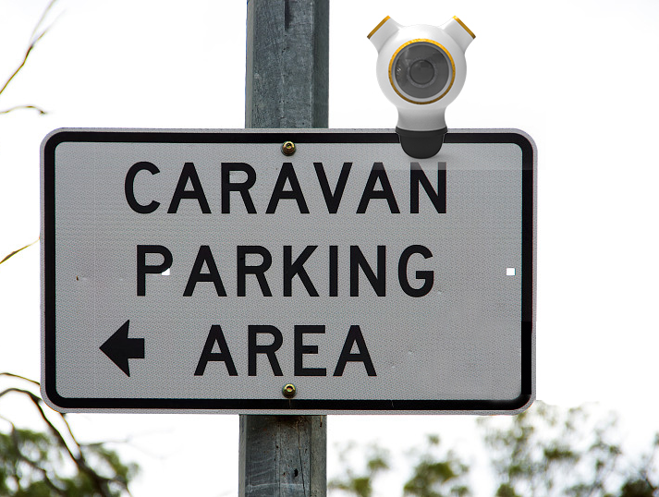
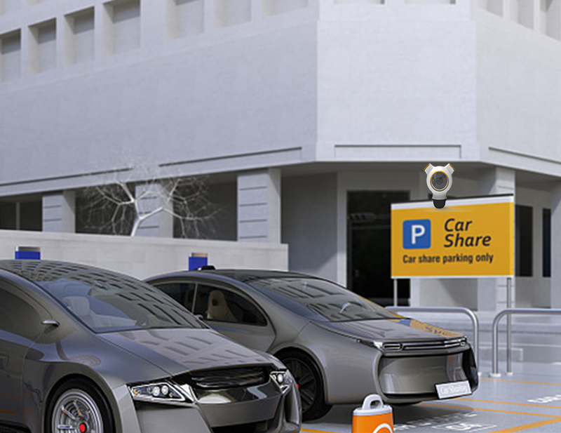
How cameras find available parking spaces
Underground Car Park
Road Side Park
Camera
Notes:
Now car owners only know where the parking lots exist, but not how many spaces available in one parking lot. We only talk about the road side park now, because for the underground car park, different property management companies has their own interests. When we finally finish this design, those companies will find our value and join us.

Slide 4
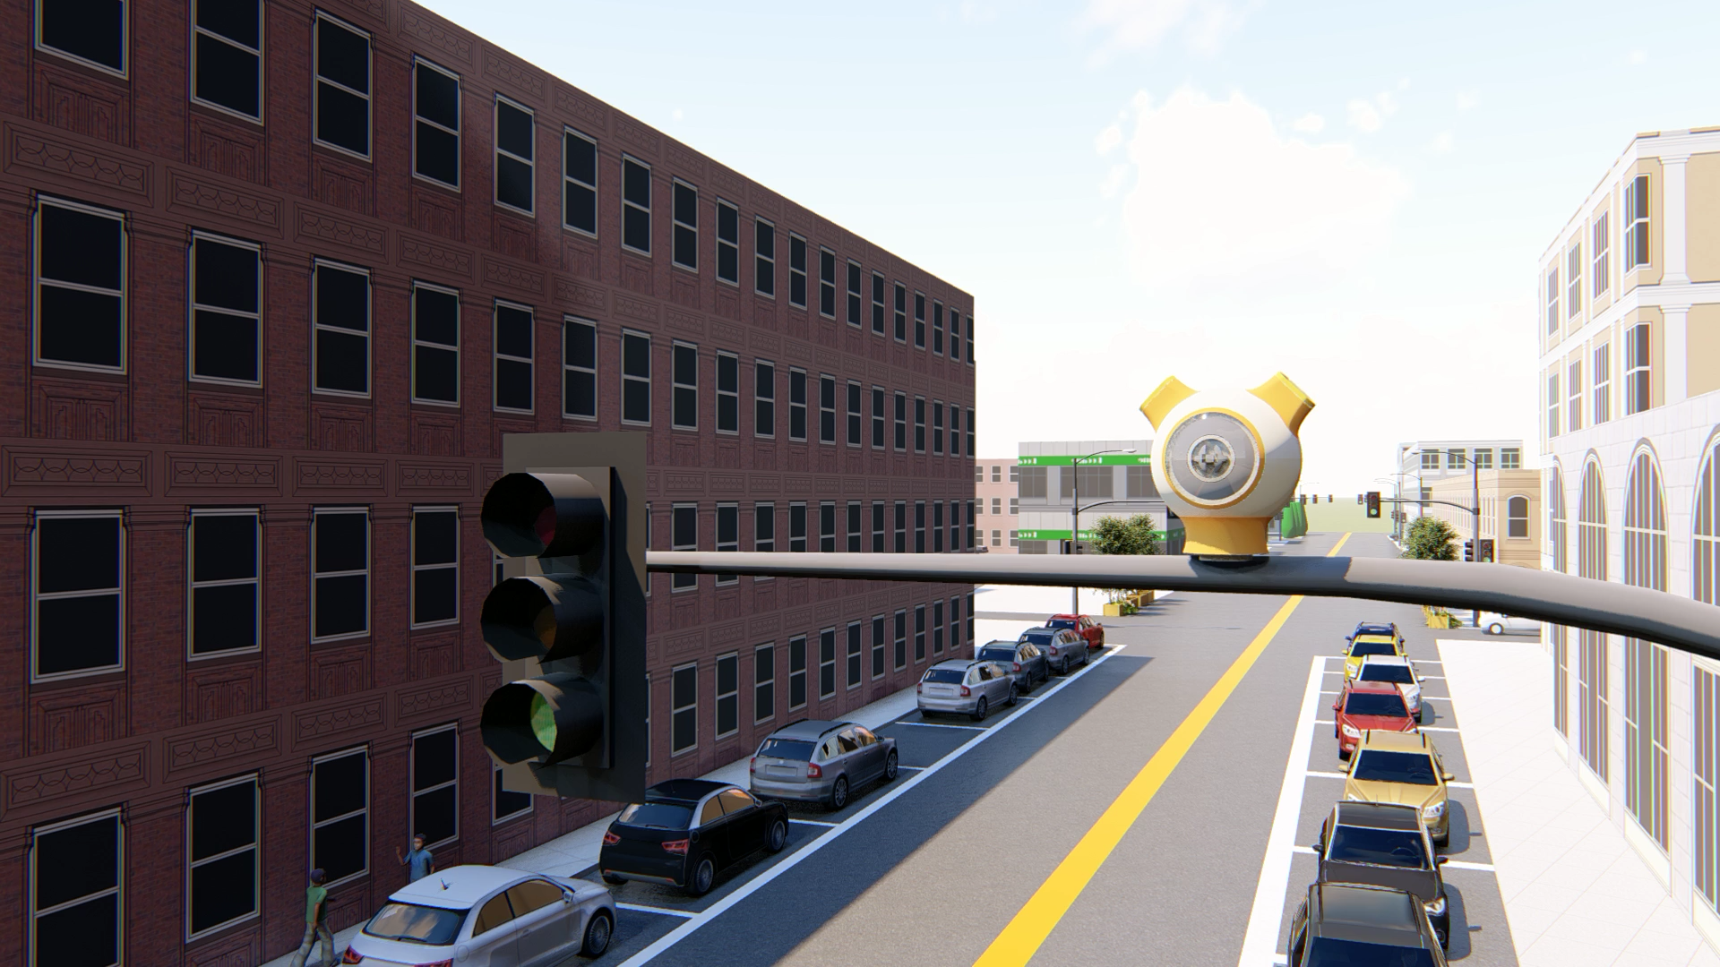
Notes:
We build this camera, and this is a 3D model. it is different from the Road surveillance camera at the crossroads. This camera is only installed in a smaller, shorter street near the building.

Slide 5
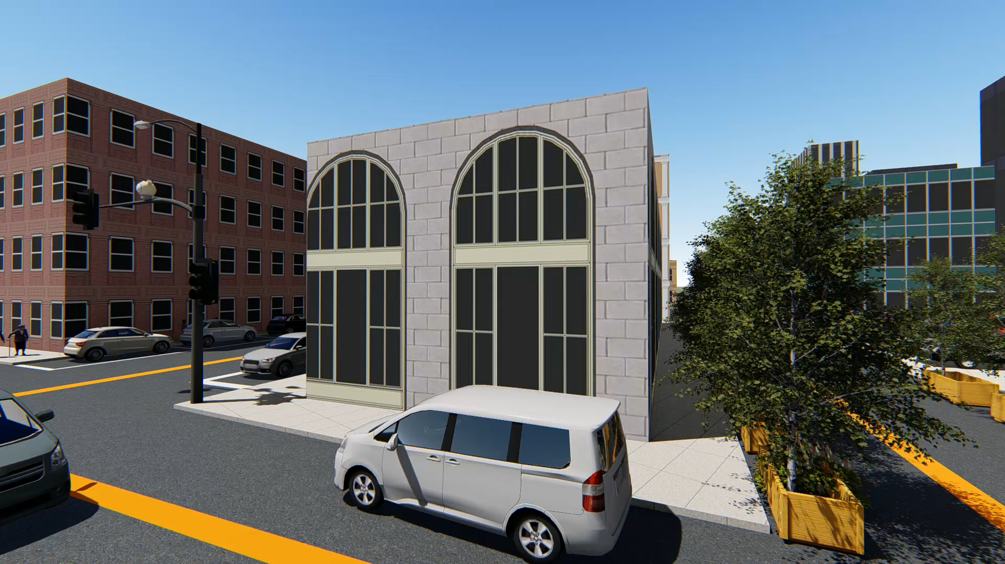
Notes:
Now we see a car that wants to park. If we collect the data from the picture from the camera, and recognize the available parking spaces. The second half of this video shows exactly what the camera will see.

Slide 6
02
For car owners
Notes:
with the app. Let’s show what will happen.

Slide 7
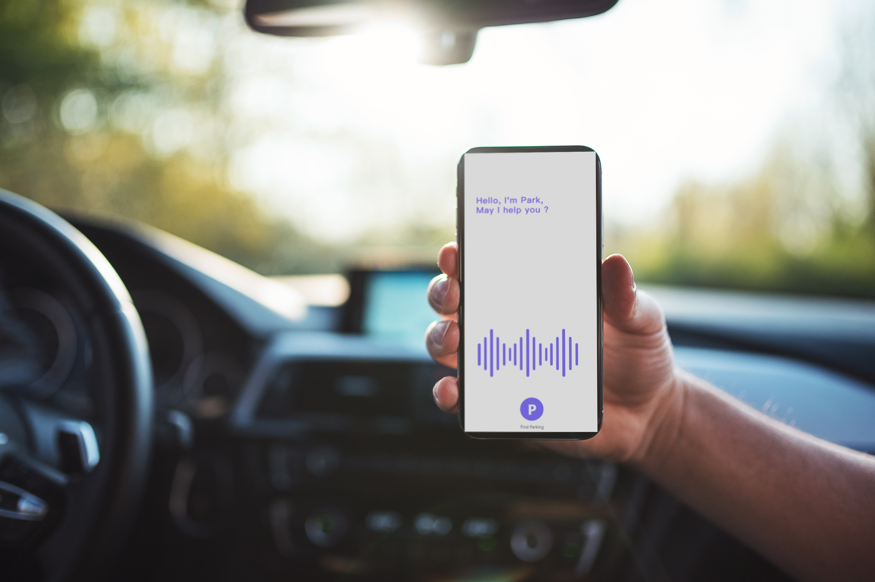

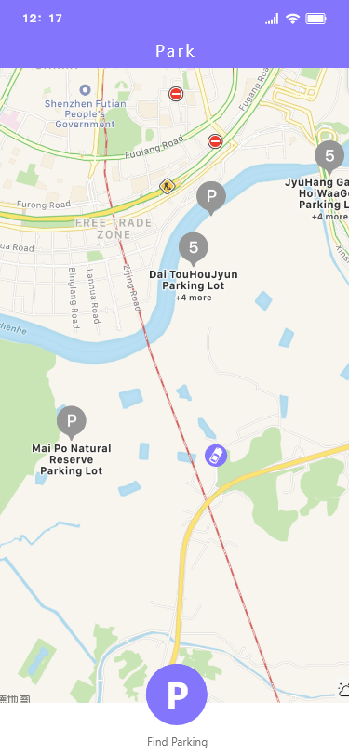
CAPTAIN PARK

Slide 8
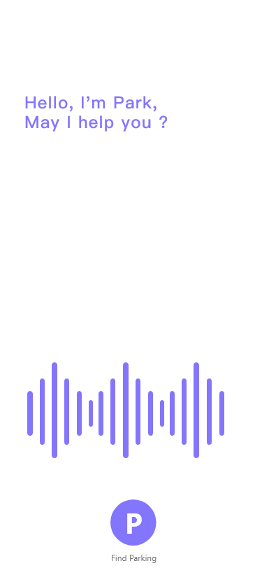

Slide 9
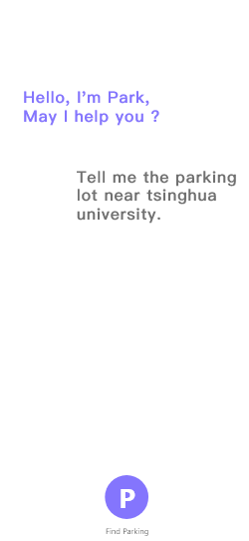

Slide 10
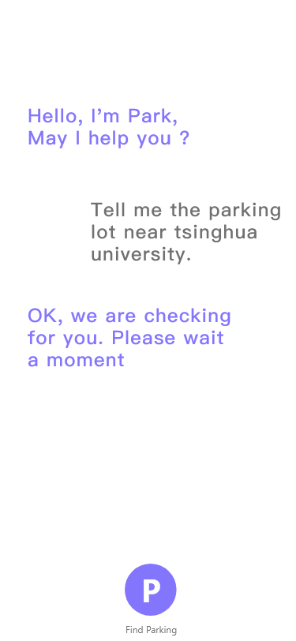

Slide 11
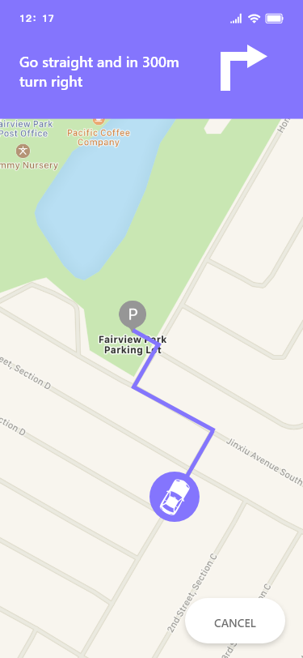

Slide 12
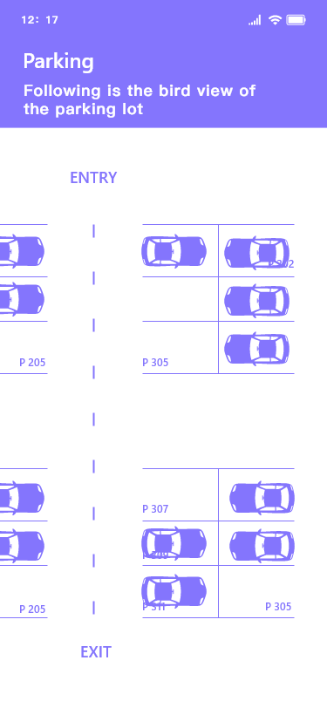

Slide 13
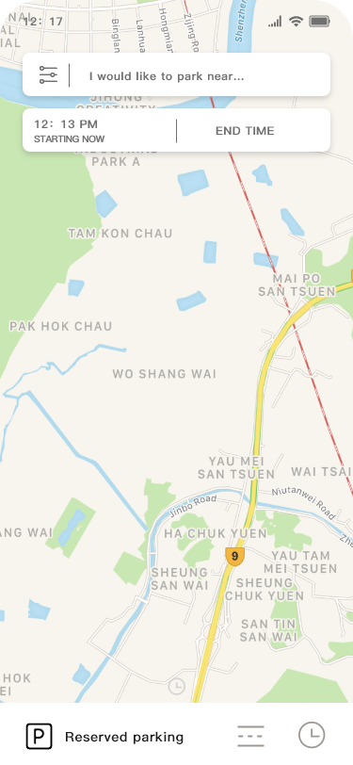
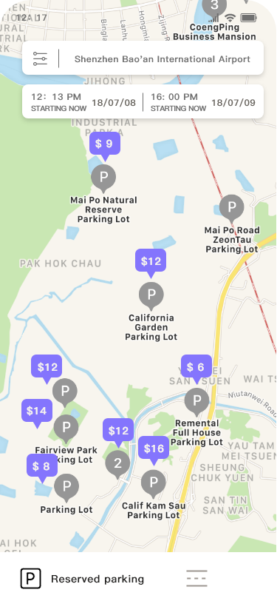
When you want to check the parking space in advance
input destination
start time will be atuo filled
Search Result
Parking indicator with pricing. User can tap on it to view details or get directions or just follow her pass to reach there.
Reserved parking
Parking Timer

Slide 14
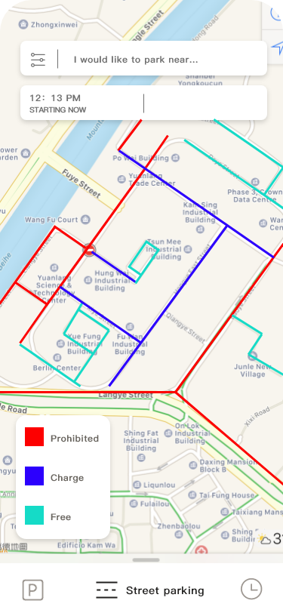
Street Parking
This is the most useful feature which helps the user find parking for short duration.
This highlighters will indicate meter,free or prohibited parkings in the nearby area of the destination.
I tried to keep the UI modern and simple.This was important because of the busy schedule of the user.They should be able to get the information and learn the system quickly. Entering any infoemation shouldn't be overwhelming for them as they're already frustrayed.
on street legendn
Street Parkingn

Slide 15
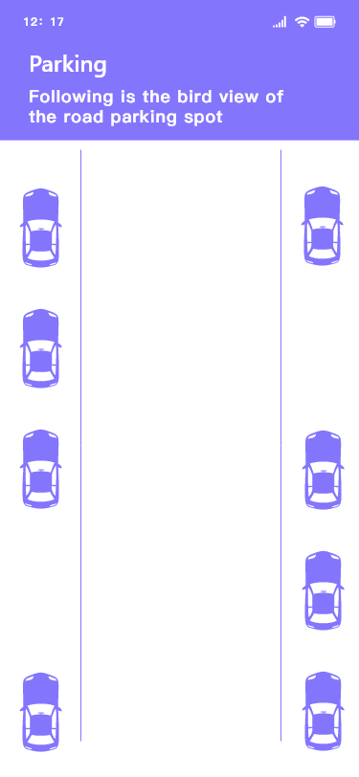
Highlights

Slide 16
03
For government

Slide 17
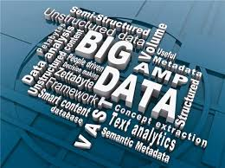
Monitoring
BY GOVERNMENT
For the government：
· Data Sources
Real-time image data and video data
· Algorithms
Decision trees, PCA, ARIMA and so on
· Effects
Increase the urban management efficiency
Save the human resources
Reduce the traffic conjestion
Notes:
We build a backend system for government to monitor the real time image data and video data captured by the cameras.
The system can show the real time data in different dimensions and give predictions by using decision trees, principal component analysis(PCA), regression integral moving average model(ARIMA) and other data mining algorithms.
Government officers can use these data and predictions to make decisions on city traffic management to increase the urban management efficiency, save the human resources and reduce the traffic conjestion.

Slide 18
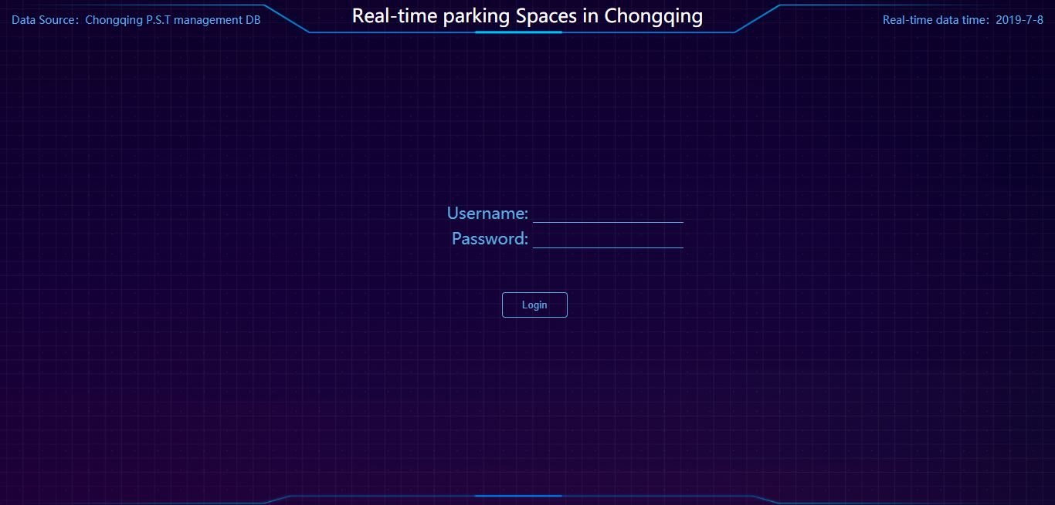
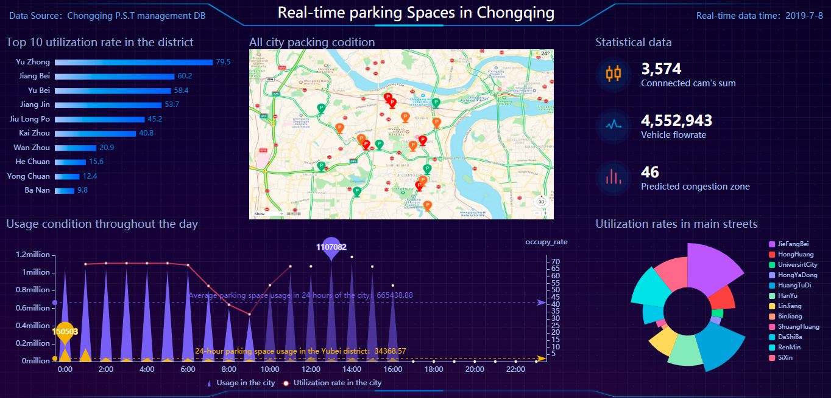
Monitoring
BY GOVERNMENT
B/S Architecture
Used by governmental agents
Security and Accuracy
TOP 10 districts with the highest parking occupancy rate
Real-time road imags and vedios
Main streets parking spaces utilization rate
Parking spaces usage condition recording throughout the day
Prediction data
Notes:
Now we will show our system prototype.
We plan to develop a system based on C/S architecture, but we don't have so many time to build a complete one. So we quickly iterate through a web version of the prototype.
On this system, we take Chongqi City as an example,
we can see the districts which have a top 10 real time parking spaces utilization rate.
The center of the screen displays the real conditions of the city parking conditions.
The system also calculate the vehicle flowrate, congestion zone and the sum of the cameras connected to the system.
We also record the parking spaces usage condition throughout the hole day, the diagram shows the average value, maximum of the hole city and the center of Chongqi City YUBEI district.
The nightingale chart in the lower right corner shows the utilization of the parking spaces of the main streets of the city to help the offiers decide how to arrange policemen to direct traffic.
Cause we haven't build such a completed camera system in the city, all the data in this interface is simulated data. Once we build a camera system to cover the hole city, we can obtain data in the database through reserved API interface.

Slide 19
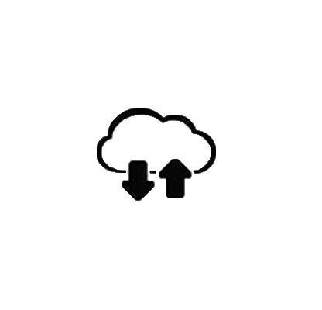

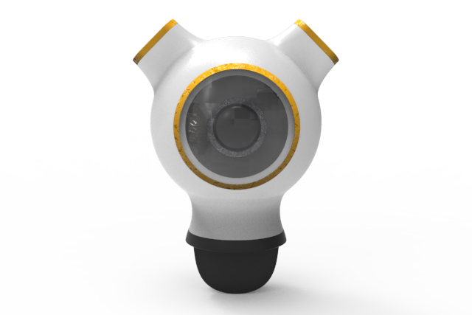

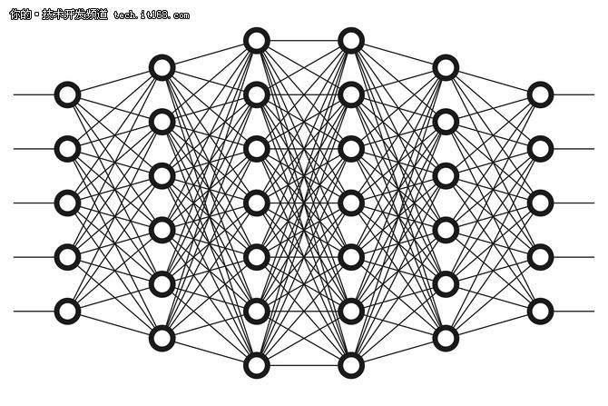

Framework of our system
User interface
Object recognition
Data storage
Process server
Data collection
Real-time monitor
Notes:
Convolutional neural network

Slide 20
04
For Value-added service

Slide 21
Value-added service in the future
Underground parking lot
Cooperation
B
D
A
C
E
Road side parking lot
Other service
Smart parking

Slide 22
Thanks
Road Side Park Detect System
Chen xi; Pang Zhengqi; Su Zhaofan; Xu Mengru; Yang Liuqing

